Slide 1

Character Writing Robot
TEAM 6
Team Details :
Amarjit Prasad (BE-EXTC)
Abhishek Kharche (BE-COMP)
Chinmay Pednekar (BE-COMP)
Vaibhav Naidu (BE-COMP)
SHIVAJIRAO S. JONDHALE COLLEGE OF ENGINEERING
DOMBIVLI

Slide 2
Index
Objective
Introduction to Spark V
Custom motor driver
Wireless communication
Programming the motor
Working of mechanism
Character mapping
Simulation
GUI
Applications

Slide 3
Project objective
The project objective is to explore the “writing capability of robots”
We program a Spark V robot ie. ATMEGA 16 based to write on a paper with pen
A mechanism makes the pen move in different directions
Input is given through user interface using XBEE (Based on zigbee protocol, IEEE 802.15.4)

Slide 4
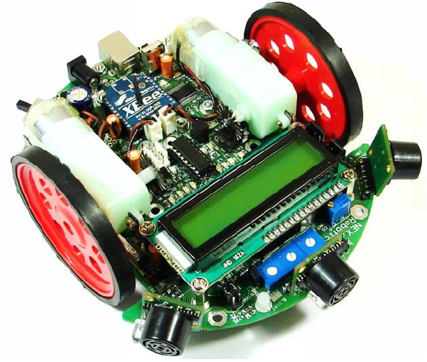
Spark V ATMEGA16 Robot
It is based on ATMEGA16 microcontroller.
The robot is equipped with:
3 analog white line sensors,
3 analog IR Proximity sensors,
3 directional light intensity sensors
LCD display
Buzzer
Both serial and wireless communication ports
Has auxiliary and battery power supply
Ultrasonic range sensors (optional)

Slide 5
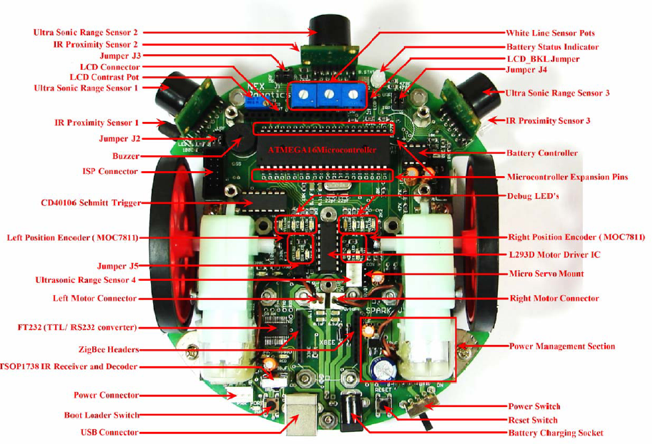

Slide 6
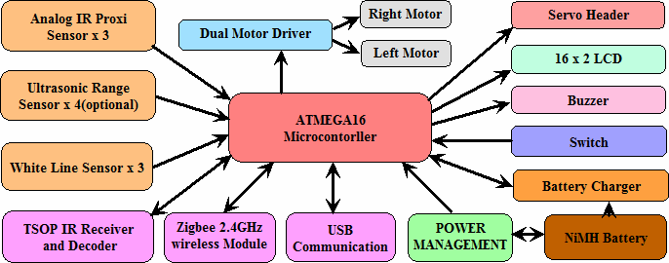
Spark V functional block diagram

Slide 7
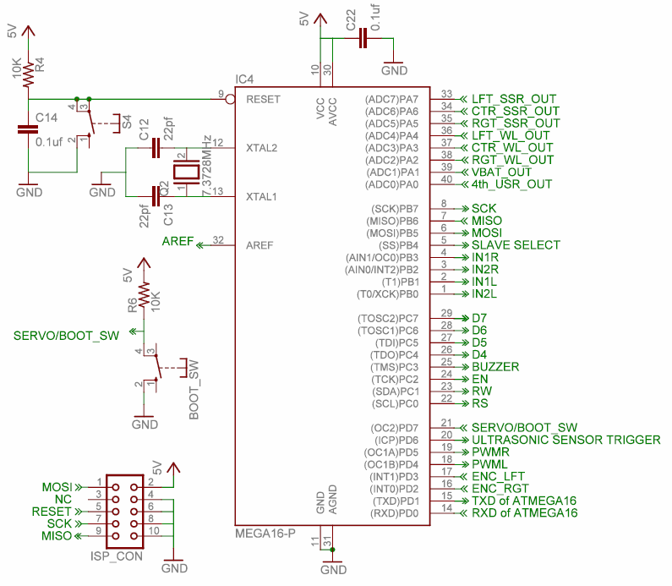

Slide 8
ATMEGA 16
It is a 8 bit microcontroller having 40 pins
Has 32 programmable I/O lines split into 4 ports
3 timer pins
Operating voltage is 4.5 to 5.5 V
Dedicated pins for crystal oscillator and reset
Max operating frequency 16MHz
Notes:
Timers- 2 8bits and 1 16bit

Slide 9
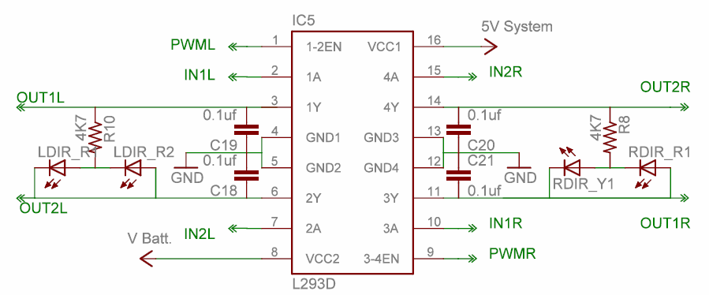
L293D motor driver

Slide 10
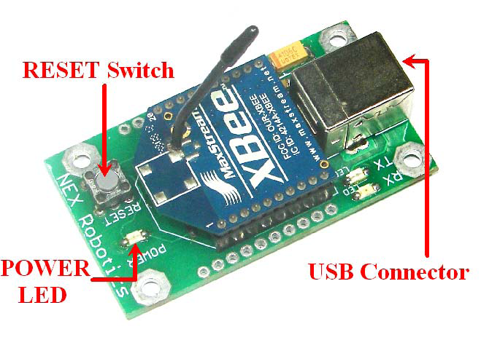
ZigBee Advantages
Range is from 30 m to 100 m
Power is 3.3 V
RF Data Rate is 250,000 bps
Retries and Acknowledgements
The XBee/XBee-PRO RF Module is designed to mount into a receptacle (socket) and therefore does not require any soldering when mounting it to a board.

Slide 11
ZigBee module
ZigBee is a protocol that is based on the 802.15.4 standard
It uses 2.4 GHz band in most of the countries worldwide
Wireless communication occurs in 5 MHz channels ranging from 2.405 to 2.480 GHz
The lower data rate of the ZigBee devices allows for better sensitivity and range
Spark robot has inbuilt pins for mounting zigbee module
It just needs a jumper setting for switching to wireless mode from serial mode

Slide 12

Serial communication setting
Notes:
Baud rate is the speed, daata bits is no of databits in a packet, parity for error checking and correction, handshake, stop bits to indicate end of packet

Slide 13
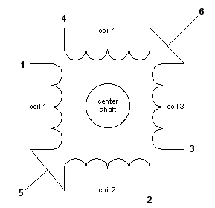
Stepper motor
How it works

Slide 14
Program for Stepper motor
int step = 3;
void stepper(int dir)
{
}
if(dir == 1)
step=4+(step+1)%4;
else
step=4+(step-1)%4;
switch(step)
{
case 4: PORTB |= 0b00001111;
PORTB &= 011111100;
break;
case 5: PORTB |= 0b00001111;
PORTB &= 011111001;
break;
case 6: PORTB |= 0b00001111;
PORTB &= 011110011;
break;
case 7: PORTB |= 0b00001111;
PORTB &= 011110110;
break;
}

Slide 15
Mechanism

Slide 16
Line Tracing

Slide 17
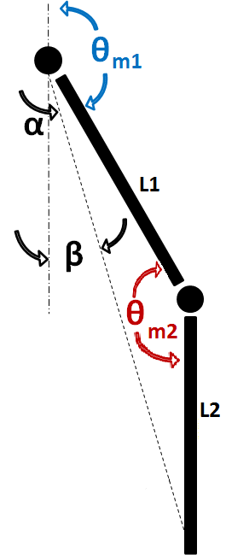
Working
L = √(X² + Y² )
L1 ² + L2 ² - L ²
cos θm2 = ----------------------
2 L1 L2
L1 ² + L ² - L2 ²
cos α = ----------------------
2 L1 L
Y
L
tan β = X / Y
θm1 = 180 - α - β
X

Slide 18
Character Mapping
X
(-50,0)
(0,0)
(50,0)
(-50,50)
(50,50)
Y
(-50,100)
(0,100)
(50,100)

Slide 19
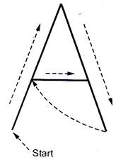
Stroke Method

Slide 20
Example
(-50,0)
(0,0)
(50,0)
Pen down
Line(-50,100, 0,0)
Line(0,0, 50,100)
Pen up
Line(50,100, -25,50)
(-50,50)
(50,50)
Pen down
Line(-25,50, 25,50)
(-50,100)
(0,100)
(50,100)

Slide 21
Simulation

Slide 22
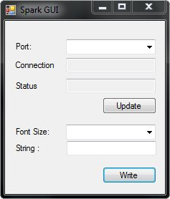
GUI
Visual C++
Select COM port at runtime
Check status of robot
Enter multiple characters at a time

Slide 23
Start
Flow Chart
Take next character from input string
Load line coordinates from memory
Proceed to start point and put pen down
Trace inbuilt path to final point and lift the pen
No
All lines of current alphabet traced ?
Yes
Move robot to next position
No
All characters in input string printed ?
Yes
Stop

Slide 24
Applications
Large Size Poster Making
License Plate / Vinyl Cutters
Use libraries in future

Slide 25
Challenges
Notes:
Make excuses as to why the project is incomplete :P

Slide 26
Thank You

